Slide 1
Project: Predict Visitor Purchases with a Classification Model in BigQuery ML
Mr. Eslam Fouad.
Educator.

Slide 2
Audience
Students
Analysts
Engineers

Slide 3
Objective
In this lab, you learn to perform the following tasks:
Use BigQuery to find public datasets
Query and explore the ecommerce dataset
Create a training and evaluation dataset to be used for batch prediction
Create a classification (logistic regression) model in BigQuery ML
Evaluate the performance of your machine learning model
Predict and rank the probability that a visitor will make a purchase

Slide 4
Materials
GCP
BigQuery
Machine Learning Models
Feature Engineering
Python

Slide 5
Procedure

Slide 6
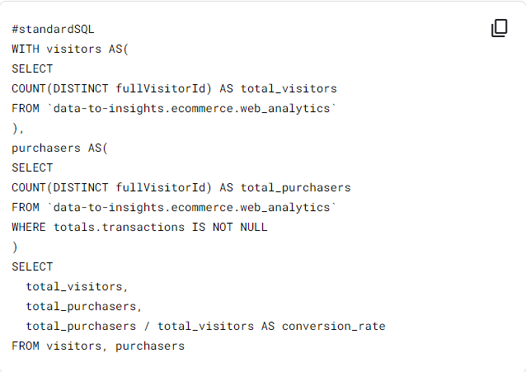

Slide 7
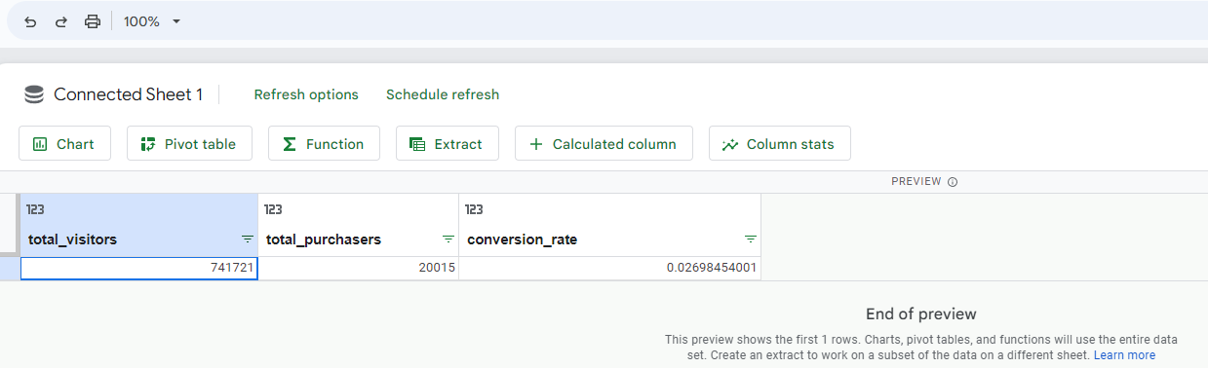

Slide 8
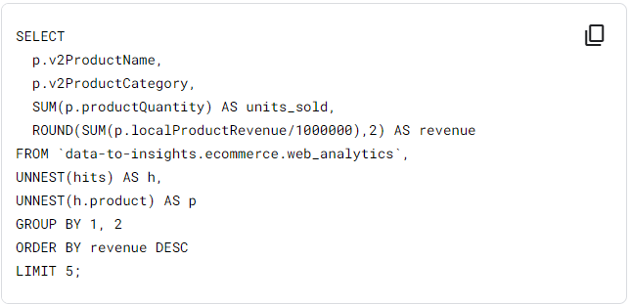

Slide 9
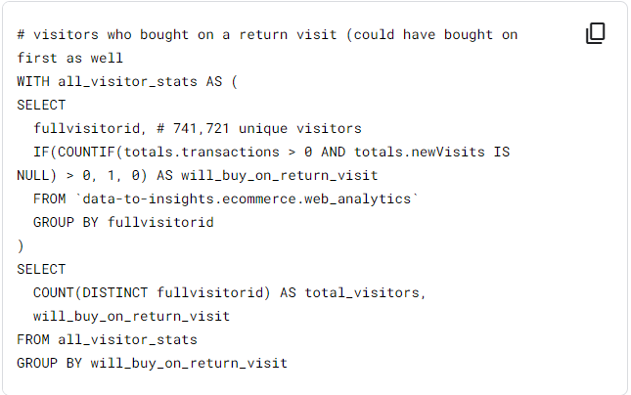

Slide 10
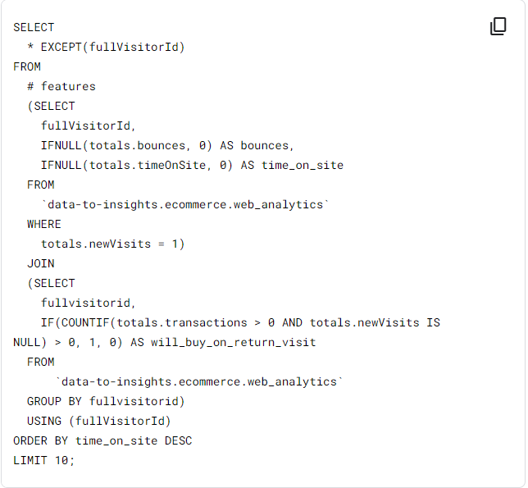

Slide 11
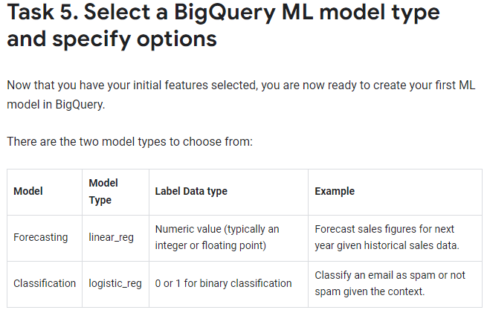

Slide 12
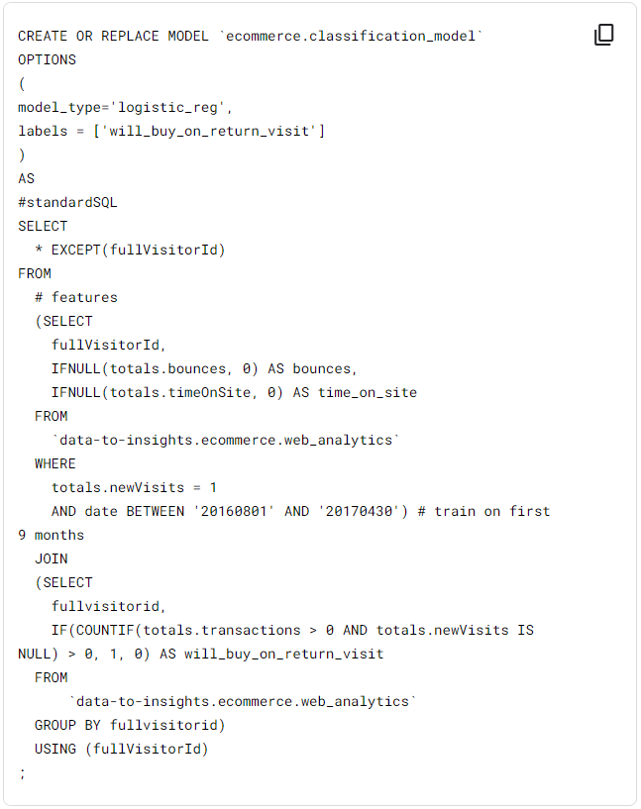

Slide 13
